Slide 1

Data Structure [09CE2303] Unit:-4
PRESENT BY
DOLLY N SHILU
Assistant Professor
Diploma-CE

Slide 2
Tree

Slide 3
Outline
Introduction
Binary Tree
Operation
Tree traversal
In-Order
Pre-Order
Post-Order
Advantage-Disadvantage

Slide 4
Introduction
Tree is a Non-Primitive Non-Linear data Structure.
It is use for Rearranging data to the Binary Search Tree manner.
It organize data in a way that is easy to navigate and search. It is a collection of nodes that are connected by edges and has a hierarchical relationship between the nodes.
The tree with no nodes is called the null or empty tree.
There are many tree structure Ex:-Binary search Tree, Ternary Tree, N-ary Tree, AVL tree etc

Slide 5
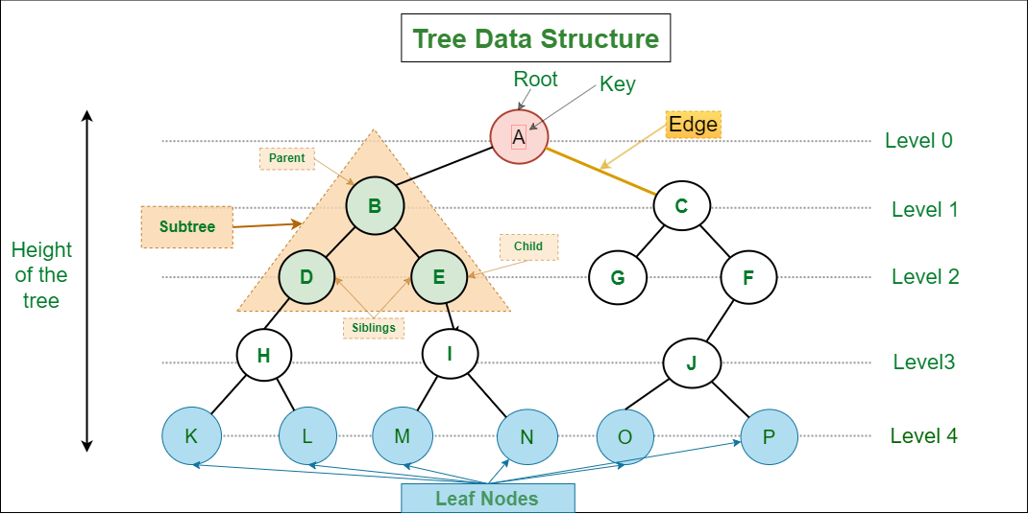
Binary Tree structure

Slide 6
Introduction
Root node:-The root node is the topmost node in the tree hierarchy. In other words, the root node is the one that doesn't have any parent. In the above structure, node A is the root node of the tree.
If a node is directly linked to some other node, it would be called a parent-child relationship.
Parent node:- If the node contains any sub-node, then that node is said to be the parent of that sub-node. B is parent node of D,E and C is parent of F,G.
Child node: If the node is a descendant of any node, then the node is known as a child node. D,E is child node of B.

Slide 7
Continue
Sibling: The nodes that have the same parent are known as siblings ex:- node D,E are siblings.
Leaf Node:- The node of the tree, which doesn't have any child node, is called a leaf node. A leaf node is the bottom-most node of the tree. There can be any number of leaf nodes present in a general tree. Leaf nodes can also be called external nodes K,L,M,N,O,P nodes are leaf node.
Internal nodes: a node has at least one child node known as an internal node.
Traversing:-Traversing means passing through nodes in a specific order.
Edges :-path between two nodes are called edge.

Slide 8
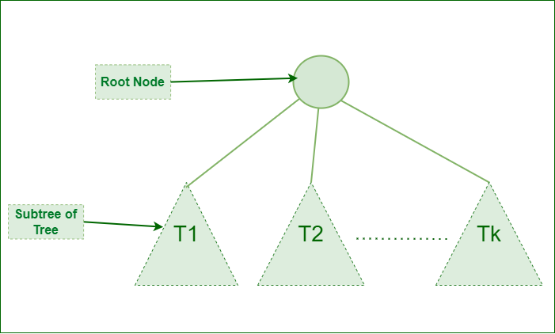
Continue…
Sub-tree :- Subtree represents the descendants of a node.
Ancestor of a Node: Any predecessor nodes on the path of the root to that node are called Ancestors of that node. {A,B} are the ancestor nodes of the node {E}
Descendant: Any successor node on the path from the leaf node to that node. {E,I} are the descendants of the node {B}.

Slide 9
Binary Search Tree
Binary Search Tree (BST) is Non primitive Non-Linear data structure.
In this Binary tree which has the property that all elements in left sub-tree of node N are less than content of N(value of root node) and all elements in right sub-tree of N are greater than or equal to content of N(value of root node) is called Binary search tree(BST).
each node has 0, 1, or at the most 2 children.

Slide 10
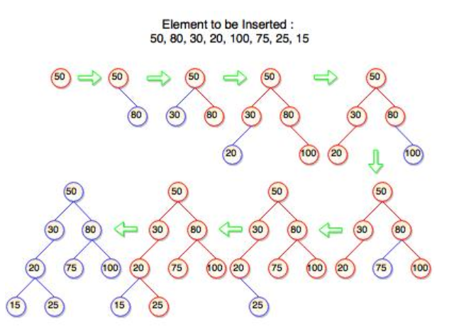
Binary Search Tree Structure

Slide 11
Representation of Tree
There are two way to represent tree.
1.Sequential Manner(Array)
2. Linked list Manner

Slide 12
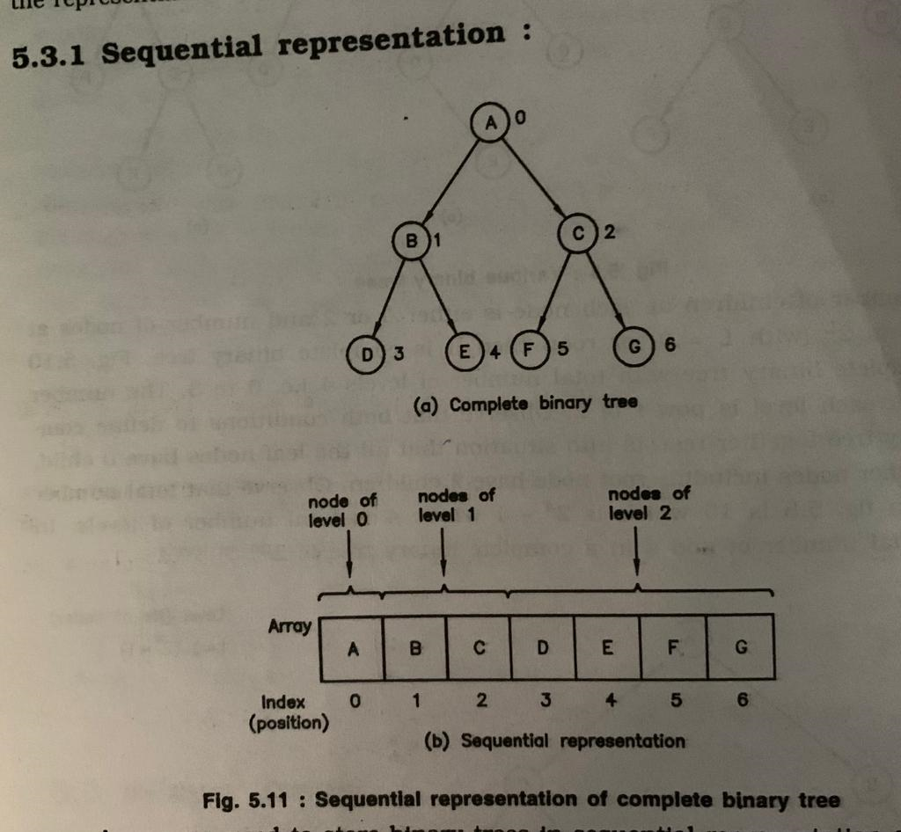
Sequential Manner(Array)
1.Sequential Manner(Array)
In this manner nodes are numbered from level 0 to level n and from left to right.
If any node is missing then it is represented by Null.

Slide 13
Sequential Manner(Array)
Let us consider that we have a tree T. let our tree T is a binary tree that us complete binary tree. Then there is an efficient way of representing T in the memory called the sequential representation or array representation of T. This representation uses only a linear array TREE as follows:
The root N of T is stored in TREE [1].
If a node occupies TREE [k] then its left child is stored in TREE [2 * k] and its right child is stored into TREE [2 * k + 1].

Slide 14
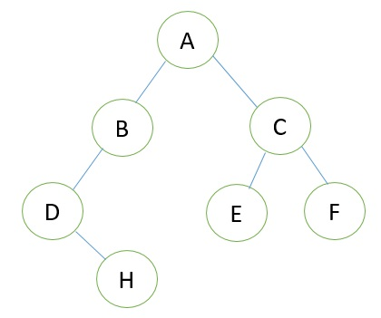
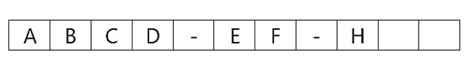
Sequential Manner(Array)

Slide 15
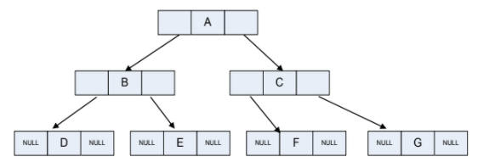
Linked list Manner
In this manner nodes are arranged using link list. Left child of any node will be stored at left pointer and right child of a node will be stored at right pointer.

Slide 16
Linked list Manner
Consider a Binary Tree T. T will be maintained in memory by means of a linked list representation which uses three parallel arrays; INFO, LEFT, and RIGHT pointer variable ROOT as follows. In Binary Tree each node N of T will correspond to a location k such that
LEFT [k] contains the location of the left child of node N.
INFO [k] contains the data at the node N.
RIGHT [k] contains the location of right child of node N.

Slide 17
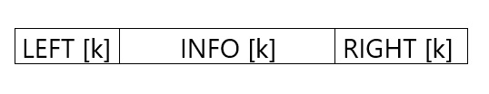
Linked list Manner
In this representation of binary tree root will contain the location of the root R of T. If any one of the subtree is empty, then the corresponding pointer will contain the null value if the tree T itself is empty, the ROOT will contain the null value.

Slide 18
Operation
Traversal :- Traversing means passing through nodes in a specific order. There are Three Method.
1) Pre-Order :-
Traverse root node
Traverse left sub-tree of root node
Traverse right sub-tree of root node
2) In-Order:-
Traverse left sub-tree of root node
Traverse root node
Traverse right sub-tree of root node

Slide 19
Continue…
3) Post-Order:-
Traverse left subtree of root node
Traverse right subtree of root node
Traverse root node first
Insert :- this will insert a node either at left sub tree or at right sub tree of a tree.
Delete:-this will perform deletion operation,
1. this will delete a node either a leaf node
2. a node with single child
3. a node with 2 child.

Slide 20
Continue…
Search:-This operation will search for a key node whether it is present in a Tree or not.

Slide 21
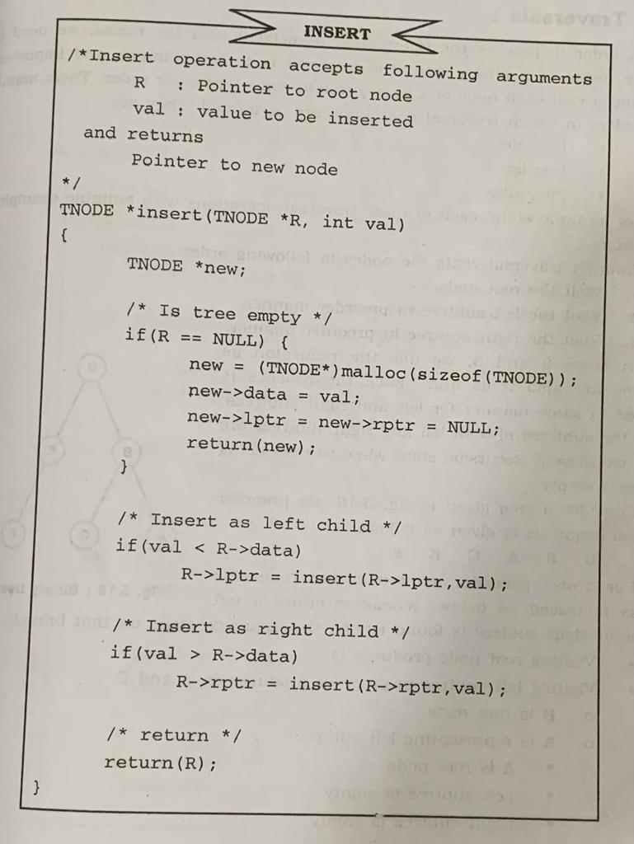
Algorithm of Insert

Slide 22
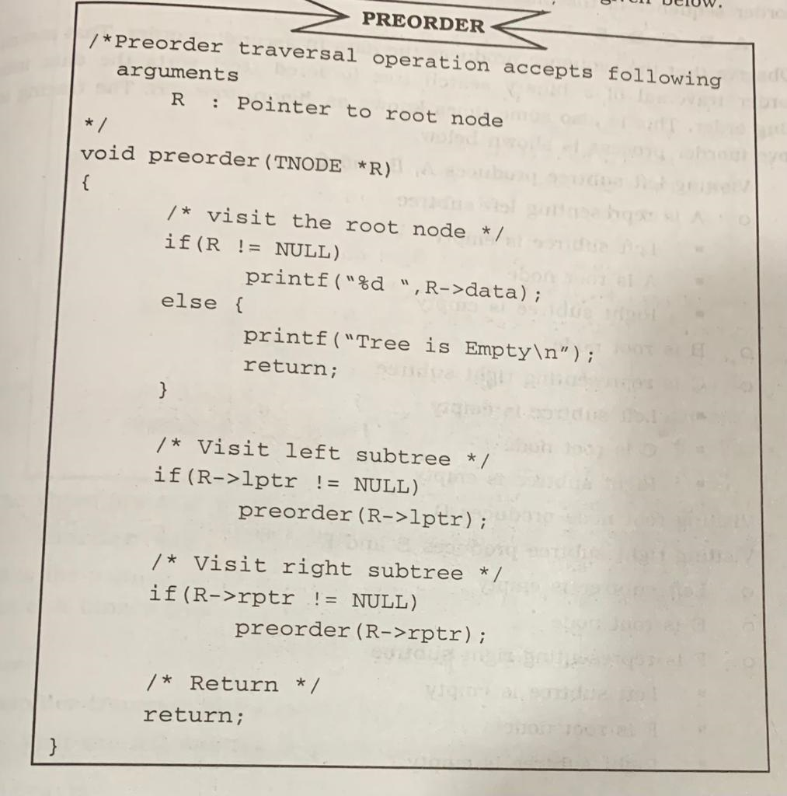
Algorithm of pre-order

Slide 23
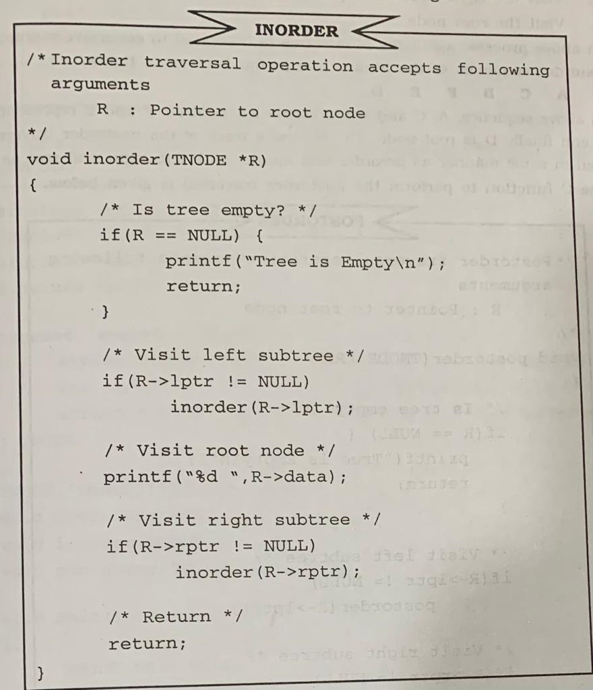
Algorithm of In-order

Slide 24
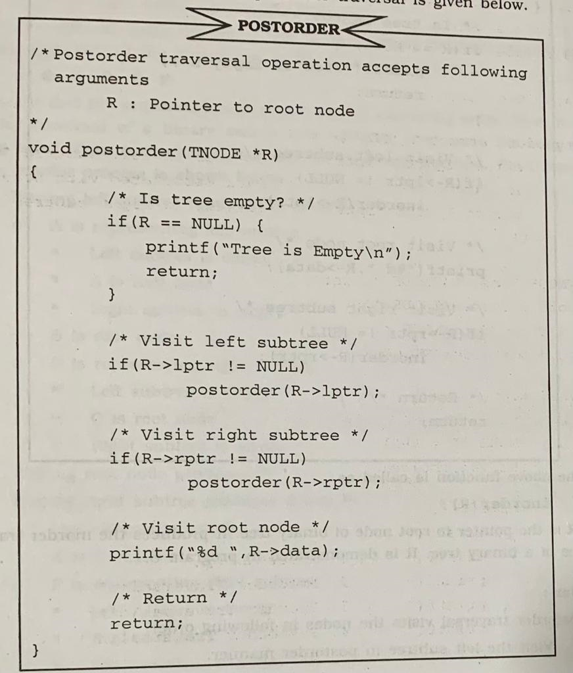
Algorithm of post-order

Slide 25
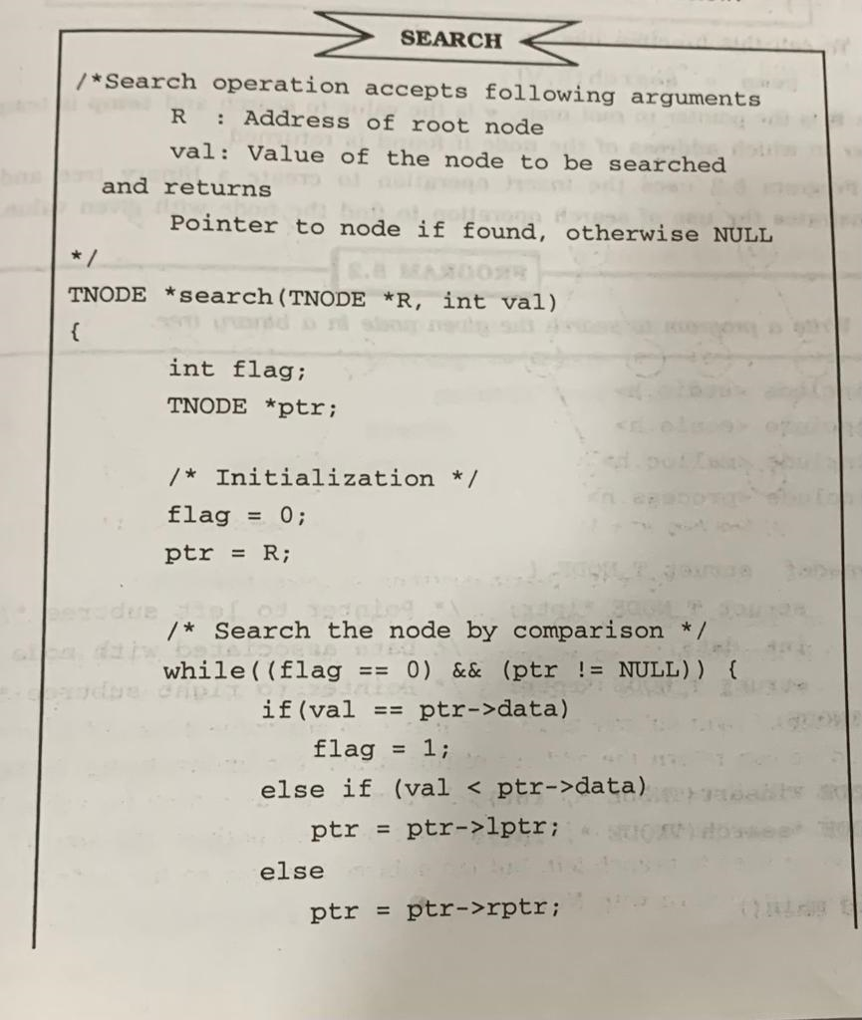
Algorithm of Search

Slide 26
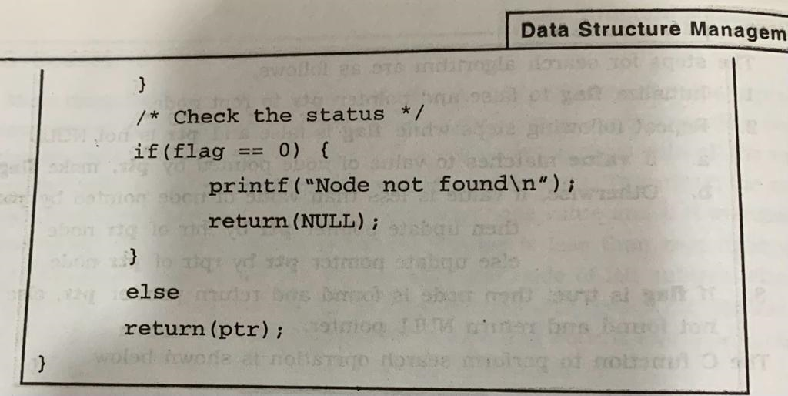
Continue…

Slide 27
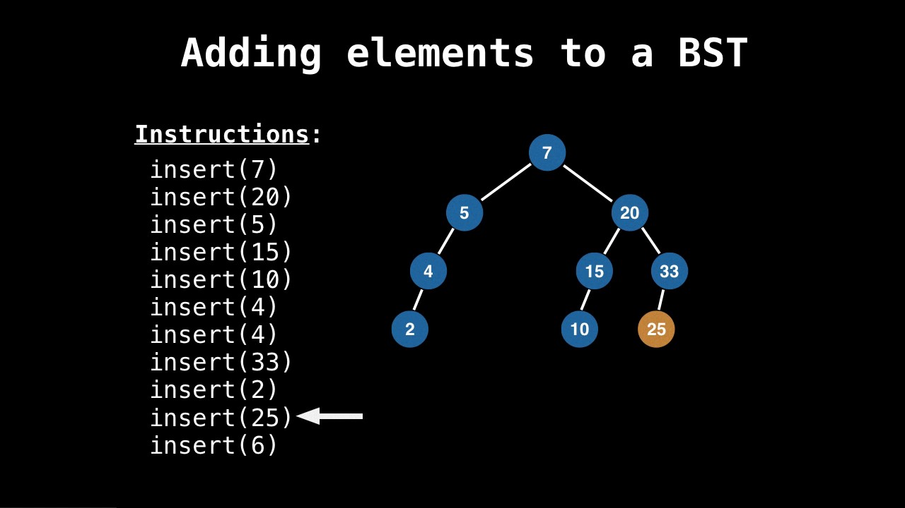
Binary tree Insert

Slide 28
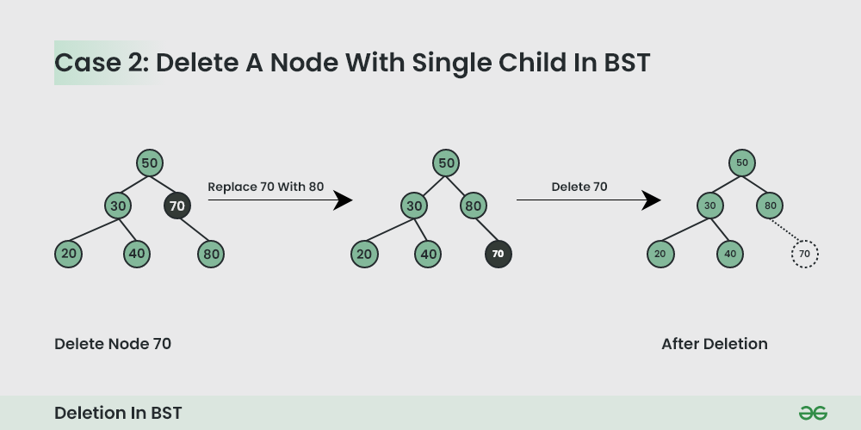
Binary tree delete

Slide 29
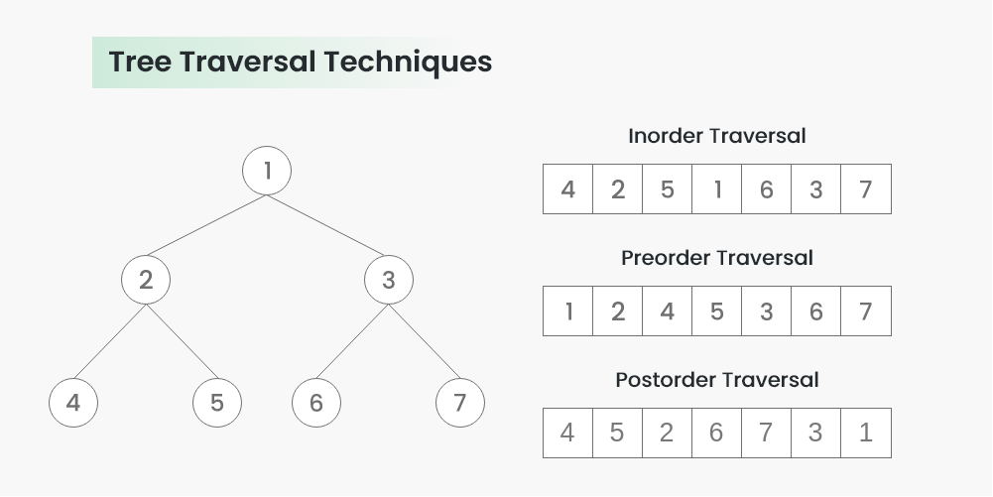
Traversal BST

Slide 30
Advantage
Efficient searching: Trees are particularly efficient for searching and retrieving data.
Flexible size:-This makes them particularly useful for applications where the data size may change over time.
Easy to traverse:-Traversing a tree is a simple operation, and it can be done in several different ways depending on the requirements of the application. This makes it easy to retrieve and process data from a tree structure.
Easy to maintain: Trees are easy to maintain because they enforce a strict hierarchy and relationship between nodes.
Fast insertion and deletion

Slide 31
Disadvantage
Memory overhead:- Trees can require a significant amount of memory to store, especially if they are very large. This can be a problem for applications that have limited memory resources.
Complexity:- Trees can be complex data structures, and they can be difficult to understand and implement correctly.
Limited flexibility:- While trees are flexible in terms of size and structure, they are not as flexible as other data structures like hash tables. This can be a problem in applications where the data size may change frequently.

Slide 32
THANK YOU

